Slide 1
Xtext Workshop
Thomas Fischl

Slide 2
Agenda
Xtext Overview
Grammar
Validator
Code Generator
Quick Fix
Unit Test
4 Exercises

Slide 3
What is Xtext?
Xtext is a framework for development of programming languages and domain specific languages. (Eclipse Xtext Website)
Eclipse Toplevel Project
Open Source Project
Highly Configurable Framework

Slide 4
What is a DSL?
A Domain-Specific Language (DSL) is a small programming language, which focuses on a particular domain. (Eclipse Xtext Website)

Slide 5


Who is behind Xtext?
itemis AG
Hauptsitz: Lünen, Deutschland
Consulting, Training
Sven Efftinge

Slide 6
xText Building Blocks
ANTLR
ECore Framework
OSGi
SWT
Google Guice
Xtend

Slide 7
What do you get from Xtext?
Compiler (Lexer, Parser, Reconciler)
AST (Ecore Model)
Serializer
Code Generator Environment
Eclipse Editor
Syntax Coloring
Content Assist
Validation and Quick Fixes
Refactoring

Slide 8
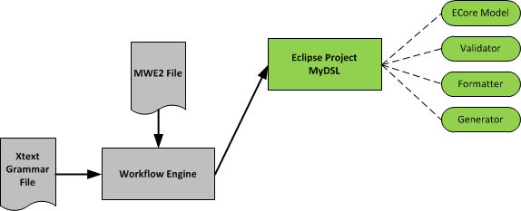
Xtext Workflow
Notes:
MWE2 => Modeling Workflow Engine 2

Slide 9
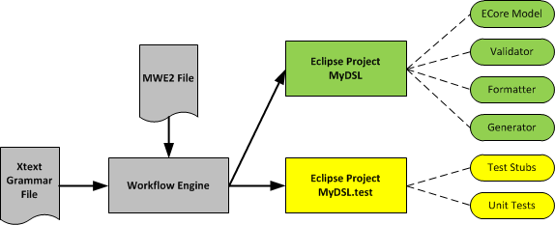
Xtext Workflow

Slide 10
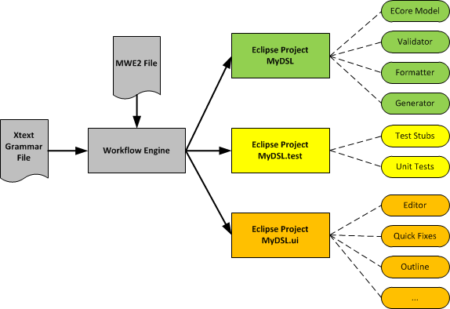
Xtext Workflow

Slide 11
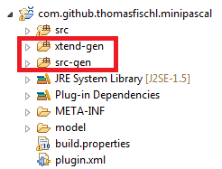
Never change generated code!

Slide 12
Xtext: Grammar

Slide 13
Xtext Grammar
Contains two definition
Language
Construction rules for the AST (Ecore Model)
Model: greetings+=Greeting*;
Greeting: 'Hello' name=NAME '!';
terminal NAME returns ecore::EString: ('A'..'Z') ('a'..'z')*;
Model: greetings+=Greeting*;
Greeting: 'Hello' name=NAME '!';
terminal NAME returns ecore::EString: ('A'..'Z') ('a'..'z')*;

Slide 14

Example - EBNF
Model =
{Greeting} .
Greeting =
"Hello" NAME "!" .
NAME =
('A'..'Z') {'a'..'z'} .

Slide 15
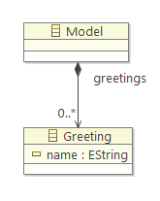
Example - Xtext Grammar
grammar org.xtext.example.mydsl.MyDsl // language name
with org.eclipse.xtext.common.Terminals // include predefined terminal rules
hidden (ML_COMMENT) // define comment style
generate myDsl // generate an ecore model for this grammar
"http://www.xtext.org/example/mydsl/MyDsl"
Model:
greetings+=Greeting*;
Greeting:
'Hello' name=NAME '!';
terminal NAME returns ecore::EString:
('A'..'Z') ('a'..'z')*;
terminal ML_COMMENT: // terminal rule
'/*'->'*/';

Slide 16
Xtext Grammar: Language

Slide 17
Xtext Grammar: Parser Rule
VarDecl:
"VAR" vars+=
VarName ("," vars+=VarName)*
":" "INTEGER" ";" ;
Hint: Each parser rule is converted into an ECore class.

Slide 18
Xtext Grammar: Terminal String
VarDecl:
"VAR" vars+=
VarName ("," vars+=VarName)*
":" "INTEGER" ";";

Slide 19
Xtext Grammar: Alternatives
Fact:
var=IDENT |
number=NUMBER |
"(" expr=Expr ")";

Slide 20
Xtext Grammar: Repetition
Expr:
term=Term (terms+=ExprExt)*;

Slide 21
Xtext Grammar: Grouping
Expr:
term=Term (terms+=ExprExt)*;

Slide 22
Xtext Grammar: Terminal Rule
terminal ID :
('a'..'z'|'A'..'Z'|'_') ('a'..'z'|'A'..'Z'|'_'|'0'..'9')*;

Slide 23
Xtext Grammar: AST

Slide 24
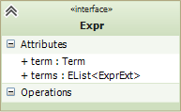
Xtext Grammar: Assignments
Expr:
term=Term (terms+=ExprExt)*;

Slide 25
Xtext Grammar: Cross Reference
Transition :
event=[Event] '=>' state=[State];
Event: ....;

Slide 26
Xtext Grammar: Terminal Rule
terminal NUMBER returns ecore::EInt:
('0'..'9')+;

Slide 27
Demo Project: Mini Pascal

Slide 28
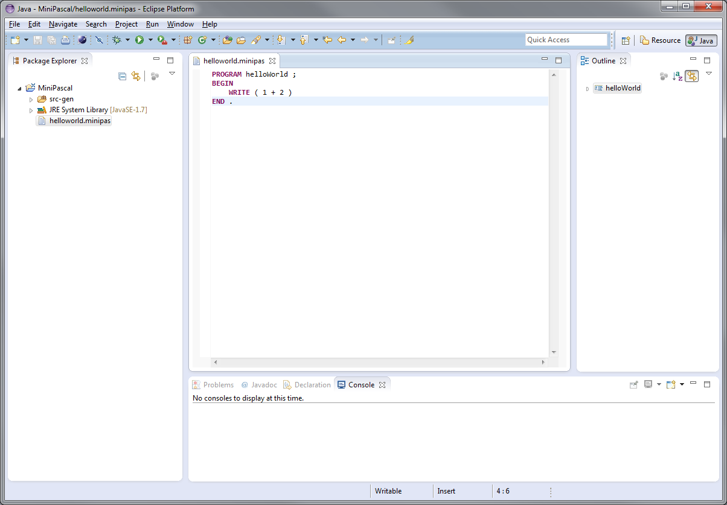
Editor

Slide 29
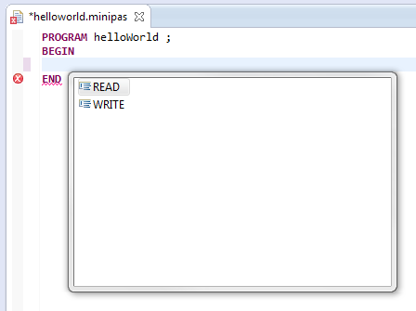
Content Assist

Slide 30
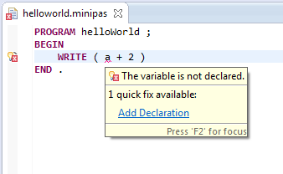
Validator & Quick Fix

Slide 31
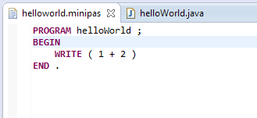
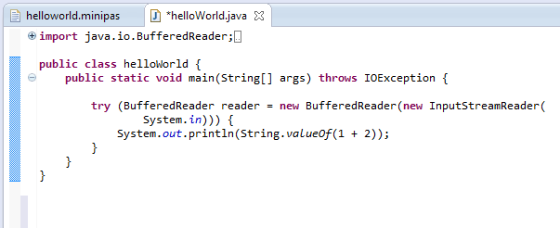
Code Generator

Slide 32
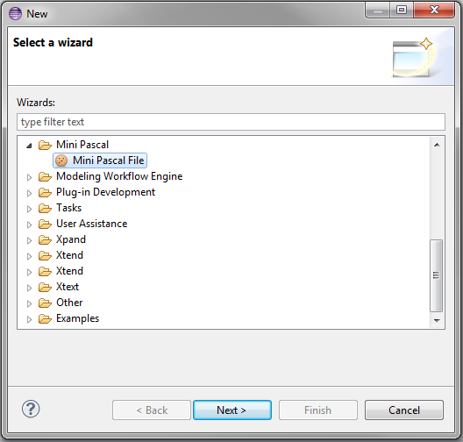
New File Wizard

Slide 33
Exercise 1
Mini Pascal Xtext Grammar

Slide 34
Mini Pascal Grammar – EBNF
MP = "PROGRAM" ident ";"
[ VarDecl ]
"BEGIN" StatSeq "END" "." .
VarDecl = "VAR" ident { "," ident } ":" "INTEGER" ";” .
StatSeq = Stat { ";" Stat } .
Stat = [ ident ":=" Expr
| "READ" "(" ident ")"
| "WRITE" "(" Expr ")"
] .
Expr = Term { ( "+" | "-" ) Term } .
Term = Fact { ( "*" | "/" ) Fact } .
Fact = ident | number | "(" Expr ")" .

Slide 35
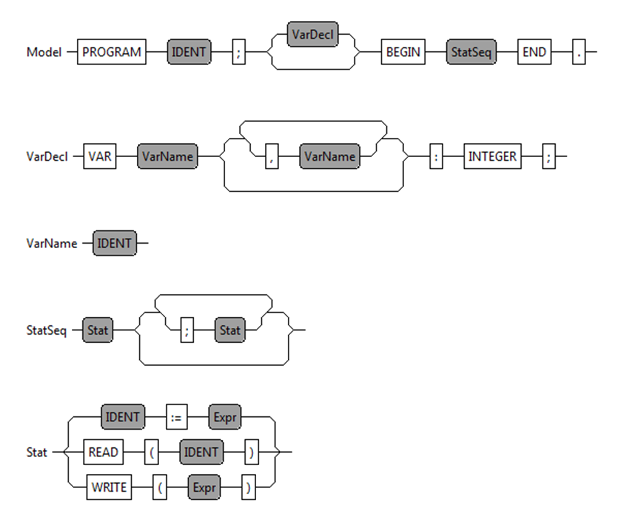
Mini Pascal - Syntax Diagram

Slide 36
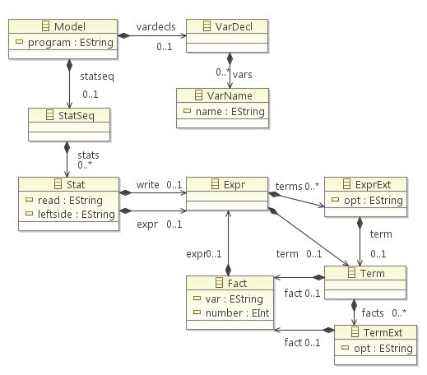
Mini Pascal – ECore Diagram

Slide 37
Mini Pascal Grammar – Xtext (1)
Model:
"PROGRAM" program=IDENT ";"
(vardecls=VarDecl)?
"BEGIN"
statseq=StatSeq
"END" ".";
VarDecl:
"VAR" vars+=VarName ("," vars+=VarName)* ":" "INTEGER" ";" ;
VarName:
name=IDENT ;

Slide 38
Mini Pascal Grammar – Xtext (2)
StatSeq:
stats+=Stat (";" stats+=Stat)* ;
Stat:
leftside=IDENT ":=" expr=Expr
| "READ" "(" read=IDENT ")"
| "WRITE" "(" write=Expr ")" ;

Slide 39
Exercise: Description
Download the grammar artefact and copy it into the Pascal.xtext file
http://goo.gl/7uPtOx
Complete the grammar
Generate all artefacts
Run Eclipse with Plugin

Slide 40
Mini Pascal Grammar – Xtext (3)
http://goo.gl/7rNPLB
Expr:
term=Term (terms+=ExprExt)*;
ExprExt:
(opt="+" | opt="-") term=Term ;
Term:
fact=Fact (facts+=TermExt)*;
TermExt:
(opt="*" | opt="/") fact=Fact ;
Fact:
var=IDENT | number=NUMBER | "(" expr=Expr ")";

Slide 41
Xtext: Validation Framework

Slide 42
Xtext Validation Framework
Automatic Validation
Syntactical Validation
Cross-link Validation
Custom Validation
Extends AbstractPascalJavaValidator
Implement @Check methods

Slide 43
Xtext Validation API
Add Information:
protected void info(String message, EStructuralFeature feature , int index)
Add Warning:
protected void warning(String message, EStructuralFeature feature, int index)
Add Error:
protected void error(String message, EStructuralFeature feature, int index)

Slide 44
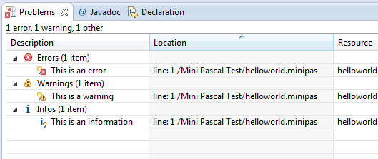
Xtext Validation API

Slide 45
Custom Validation API
public class PascalJavaValidator extends AbstractPascalJavaValidator {
@Check
public void checkVariableName(Fact fact) {
// Validation Implementation
}
}

Slide 46
Exercise 2
Double Variable Declaration Validator

Slide 47
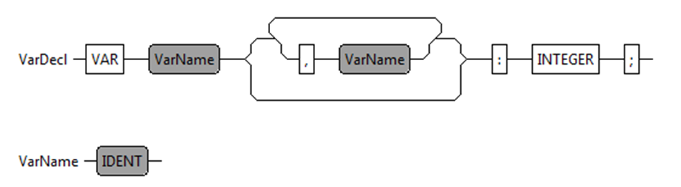
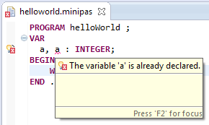
Double Variable Declaration Check

Slide 48
Exercise: Description
Download the validation artefact and copy it into the PascalJavaValidator Java file
http://goo.gl/JpFXnv
Complete the validator
Run the eclipse plugin

Slide 49
Double Variable Declaration Check
@Check
public void checkDoubleVariableDeclaration(VarDecl varDecl) {
Set<String> varNames = new HashSet<String>();
for (VarName var : varDecl.getVars()) {
if (varNames.contains(var.getName())) {
String msg = String.format("The variable '%s' is already
declared.", var.getName());
error(msg, var, PascalPackage.Literals.VAR_NAME__NAME,
REMOVE_VARIABLE, var.getName());
} else {
varNames.add(var.getName());
}
}
}
http://goo.gl/eVMfmV

Slide 50
Xtext: Code Generator Framework

Slide 51
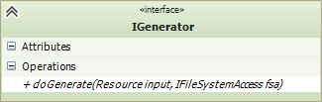
Xtext Code Generator Framework
Implement IGenerator interface
Java
Xtend

Slide 52
Xtext Code Generator Framework
Bind IGenerator implemenation in the RuntimeModel class
public abstract class AbstractPascalRuntimeModule extends DefaultRuntimeModule {
public Class<? extends IGenerator> bindIGenerator() {
return PascalGenerator.class;
}
}

Slide 53
Generator Implemenation (Xtend)
class PascalGenerator implements IGenerator {
override void doGenerate(Resource resource, IFileSystemAccess fsa) {
for (e : resource.allContents.toIterable.filter(Model)) {
fsa.generateFile(e.program + ".java", e.compile)
}
}
def CharSequence compile(Model model) '''
Implemenation
'''
}

Slide 54
Exercise 3
Expression Code Generator

Slide 55
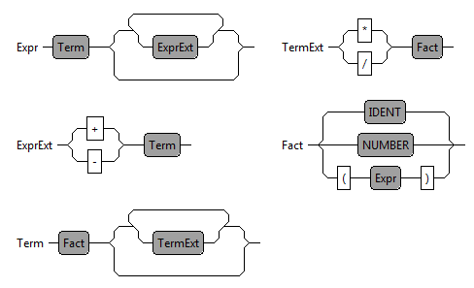
Expression Code Generator

Slide 56
Exercise: Description
Download the generator artefact and copy it into the PascalGenerator Xtend file
http://goo.gl/Vm5QWk
Complete the generator
Run the eclipse plugin

Slide 57
Xtext: Formatter

Slide 58
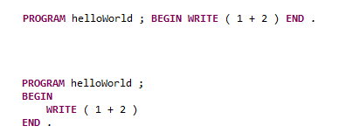
Xtext Formatter
The Formatter is a pretty print function for the DSL. (STRG + SHIFT + F)

Slide 59
Formatter Implemenation
@Override
protected void configureFormatting(FormattingConfig c) {
c.setAutoLinewrap(120);
c.setLinewrap().before(grammarAccess.getModelAccess().getBEGINKeyword_4());
c.setLinewrap().after(grammarAccess.getModelAccess().getBEGINKeyword_4());
c.setLinewrap().before(grammarAccess.getModelAccess().getENDKeyword_6());
c.setLinewrap().before(grammarAccess.getVarDeclRule());
c.setLinewrap().after(grammarAccess.getVarDeclRule());
c.setLinewrap().after(grammarAccess.getVarDeclAccess().getVARKeyword_0());
}
}

Slide 60
Xtext: Quick Fix

Slide 61
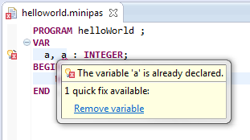
A Quick Fix …
helps the developer to improve his performance! (STRG+ 1)
is connect with a validator message.
can modify the model or the text representation.

Slide 62
Validator Implementation
@Check
public void checkDoubleVariableDeclaration(VarDecl varDecl) {
Set<String> varNames = new HashSet<String>();
for (VarName var : varDecl.getVars()) {
if (varNames.contains(var.getName())) {
String msg = String.format("The variable '%s' is already
declared.", var.getName());
error(msg, var, PascalPackage.Literals.VAR_NAME__NAME,
REMOVE_VARIABLE, var.getName());
} else {
varNames.add(var.getName());
}
}
}

Slide 63
Quick Fix Implementation
@Fix(PascalJavaValidator.REMOVE_VARIABLE)
public void fixUnusedVariable(final Issue issue, IssueResolutionAcceptor acceptor) {
String msg = String.format("Remove unused variable '%s'.", issue.getData()[0]);
acceptor.accept(issue, "Remove variable", msg, "upcase.png", new ISemanticModification() {
@Override
public void apply(EObject element, IModificationContext context) {
if (element instanceof VarName) {
VarDecl parent = (VarDecl) element.eContainer();
parent.getVars().remove(element);
if (parent.getVars().isEmpty()) {
ModelImpl model = (ModelImpl) parent.eContainer();
model.setVardecls(null);
}
}
}
});
}

Slide 64
Xtext: Unit Test

Slide 65
Unit Test for the Xtend Generator
@RunWith(XtextRunner.class)
@InjectWith(PascalInjectorProvider.class)
public class PascalGeneratorTest {
@Inject
IGenerator generator;
@Inject
ParseHelper<Model> parser;
// TODO Unit Test
}

Slide 66
Unit Test for the Xtend Generator
@Test
public void testHelloWorld() throws Exception {
testMiniPasFile("helloworld");
}
private void testMiniPasFile(String name) throws Exception {
Model model = parser.parse(readFile(name + ".minipas"));
assertNotNull(model);
InMemoryFileSystemAccess fsa = new InMemoryFileSystemAccess();
generator.doGenerate(model.eResource(), fsa);
assertEquals(1, fsa.getTextFiles().size());
String result = fsa.getTextFiles().values().iterator().next().toString();
assertEquals(readFile(name + ".output"), result);
}

Slide 67
Xtext: ByteCode Generator

Slide 68
Summary
Textual DSL Framework
Highly configurable and flexible framework
Easy code generator implemenation
Demo Project:
https://github.com/thomasfischl/xtext-workshop

Slide 69


Books
http://www.amazon.de/Domain-Specific-Languages-Addison-Wesley-Signature
http://www.amazon.de/DSL-Engineering-Designing-Implementing-Domain-Specific

Slide 70
More Infos
ANTLR http://www.antlr.org/
Xtext http://www.eclipse.org/Xtext/
Xtend http://xtend-lang.org
Google Guice: https://code.google.com/p/google-guice/
EMF: http://www.eclipse.org/modeling/emf/

